Slide 1




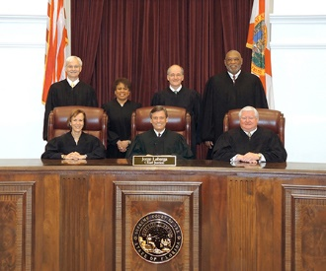
Law Day 2018
Separation of Powers:
The Essential Ingredient in Our Democracy
Notes:
Welcome to the 2018 Law Day program. The theme this year is Separation of Powers – the Essential Ingredient in our Democracy. The program has been developed for the NAWJ Informed Voters, Fair Judges Project and The Florida Bar Benchmarks Program.

Slide 2
Icebreaker Handout
Distribute icebreaker handout as participants arrive.
Participants should review and complete prior to beginning of presentation.
Notes:
As participants arrive, distribute the icebreaker handout and ask individuals to complete as everyone registers and checks in.
Debrief as presentation begins to add focus.

Slide 3

2018 Law Day Theme
Framework for Freedom focuses on the separation of powers and checks and balances within our framework of government.
The IVP presentation Separation of Powers: The Essential Ingredient in Our Democracy will focus on the separation of powers and the role of the judicial branch.
For more about the Law Day theme, visit https://www.americanbar.org/groups/public_education/initiatives_awards/law-day.html
Notes:
Highlight information on slide.
https://www.americanbar.org/groups/public_education/initiatives_awards/law-day.html

Slide 4
History of Law day
On February 3, 1958 President Dwight Eisenhower established the first Law Day.
In 1961, Congress issued a joint resolution designating May 1 as the official date for celebrating Law Day, which is subsequently codified (U.S. Code, Title 36, Section 113).
Every President since then has issued a Law Day proclamation on May 1 to celebrate the nation's commitment to the rule of law.
Notes:
Briefly review history

Slide 5
What the public knows…..
Only 26% of respondents could name all three branches of the U.S. government; 31% could not name a single one.
One in five Americans incorrectly thinks that a 5-4 Supreme Court decision is sent back to Congress for reconsideration.
Notes:
Recent findings from the Annenberg Public Policy Center tell us that the public has limited knowledge about our government. Only 26 percent of respondents could name all three branches of the US government and 31 percent could not name a single one.
One in five Americans incorrectly thinks that a 5-4 Supreme Court decision is sent back to congress for reconsideration.

Slide 6
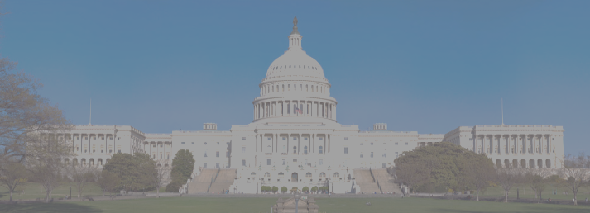
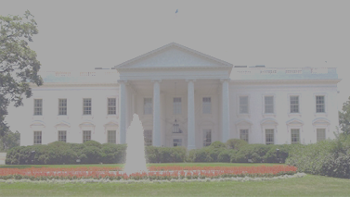
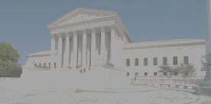
Functions of the Branches
ARTICLE 1 Legislative Branch
ARTICLE 2
Executive Branch
ARTICLE 3
Judicial Branch
Execute the law
Interpret and apply the law
Make Law
Separation of Powers: U. S. Constitution divides powers and responsibilities of government into three distinct, coequal sections or “branches” to ensure a central government in which no individual or group gains too much control. No one branch reigns supreme.
Notes:
So we begin this presentation with some of the basics. Highlight the roles and responsibilities of each branch of government. Define the term separation of powers.
These functions are found in the United States Constitution under the Article associated with each branch.

Slide 7
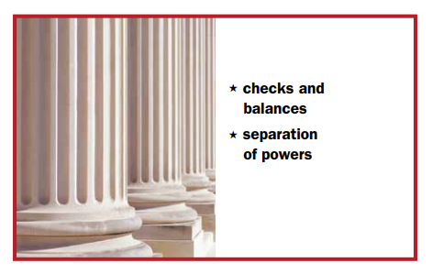
What stops one branch of government from becoming too powerful?
Notes:
Lead in for Law Day theme….

Slide 8
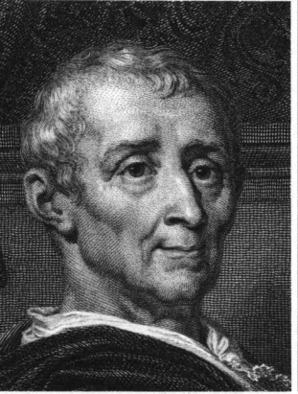

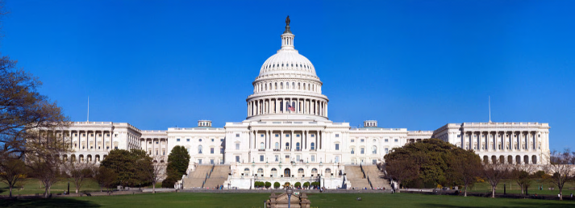
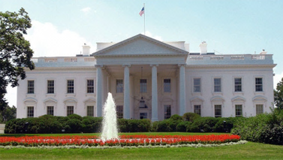
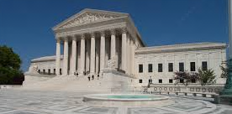
Separation of Powers
Montesquieu argued that in order to keep a government from becoming too powerful:
Power must be separated
Power must be checked
Power must be balanced
POWER
POWER
POWER
POWER
POWER
POWER
POWER
Notes:
Montesquieu was an 18th century French social and political philosopher. His publication, Spirit of the Laws, is considered one of the great works in the history of political theory and jurisprudence, and it inspired the Declaration of the Rights of Man and the Constitution of the United States. Under his model, the political authority of the state is divided into legislative, executive and judicial powers. He asserted that, to most effectively promote liberty, these three powers must be separate and acting independently.
http://www.ncsl.org/research/about-state-legislatures/separation-of-powers-an-overview.aspx
Highlight how this was integrated into our US Constitution

Slide 9

What would happen if all powers were in one branch of government?
Enforce the law
Interpret and apply the law
Make the law
Notes:
Emphasize the importance of separate branches and what would happen if all powers were given to one branch of government.

Slide 10
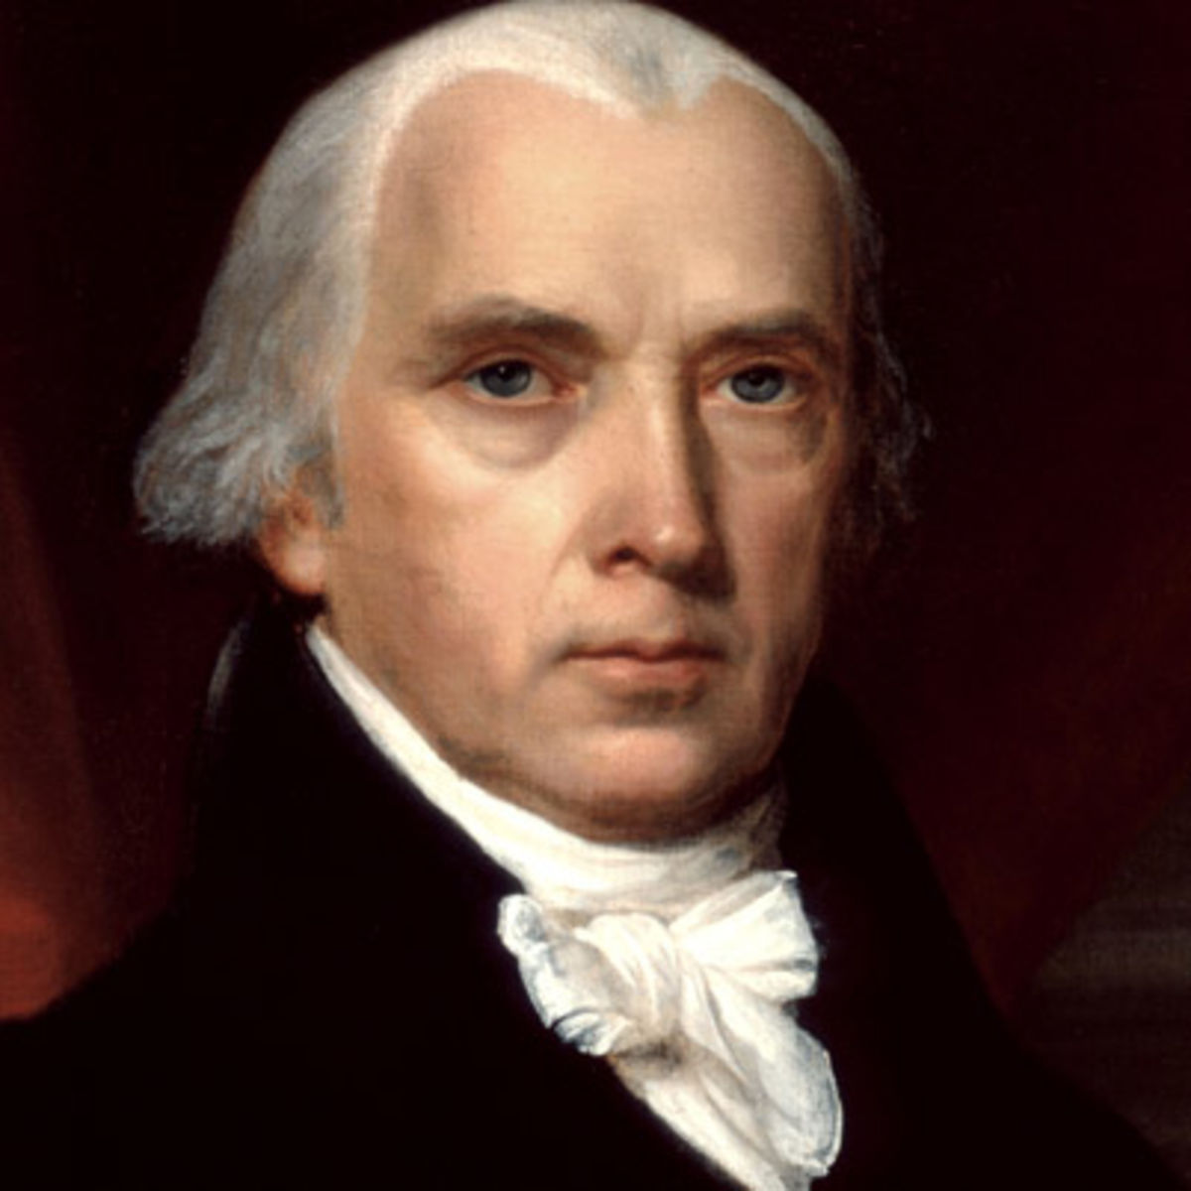
The Purpose of Separation of Powers
“The accumulation of all powers, legislative, executive, and judiciary, in the same hands, whether of one, a few, or many, and whether hereditary, self appointed, or elective, may justly be pronounced the very definition of tyranny.”
- Federalist 47 -
Notes:
Ask what Madison meant by this quote in Federalist 47
Having powers that were separated among different branches of government and limited would help prevent tyranny.
Emphasize the significance of our three branches of government – why was this significant? How was government organized under the Articles of Confederation. Consider modern implications and attempts to consolidate and/or weaken power. What about one branch having control of the others or exhibiting more control than the others?

Slide 11
Power Match
What powers do the branches of government hold?
In your group, identify the powers of the branches of government by placing a L(egislative), E(xecutive), or J(udicial) next to the powers.
Notes:
Divide the audience into small groups. Depending on the size of the audience, either have the participants work together with persons at same table or pair up with those seating close by. Use handout. To see what the audience knows, debrief.

Slide 12
Powers of the Branches
ARTICLE 1 Legislative Branch
ARTICLE 2
Executive Branch
ARTICLE 3
Judicial Branch
Execute the law
Interpret and apply the law
Make Law
Approve federal budget
Declare war
Senate approval/rejection of treaties
Senate approval/rejection of Presidential appointments
Filing for impeachment
Regulate interstate and foreign commerce
Approve or veto bills passed by Congress
Commander-in-Chief of the military
Draft the federal budget
Make treaties with other countries
Nominate federal judges and other appointed positions
Grant pardons
Decide if laws are unconstitutional (judicial review)
Decide court cases
based on jurisdiction
Settle cases between 2 or more states
Protect our rights
Notes:
Discuss the powers of the three branches and answer any questions. Here are some examples.
Highlight the judicial branch and what may happen without the judicial branch.
Question separation of powers and sometimes sharing of powers?
Impeachment for treason, bribery or other high crimes and misdemeanors (applies to Pres, VP, and other civil officers)

Slide 13
Evaluate the Powers
In a small group, decide which power of each branch is the most important power.
Now, what would happen if that power did not exist?
Notes:
Have each group decide the most important power of each branch. Team leaders should lead discussions among groups and record responses from each group about the most essential power of each branch of government.
Discussion: What would happen If that power did not exist? What would it do to the idea of separation of powers? What impact would it have on the role or function of government?

Slide 14
What do you think?
How important is separation of powers in our constitutional structure?
Would you recognize attempts by other branches, groups, or individuals to gain more control/power or to diminish the powers of another branch?
Can you think of any times in our history when one branch tried to weaken or undermine the powers of another branch?
Notes:
Ask the audience how important they think separation of powers really is in our constitutional structure. Would they be able to recognize attempts by other branches to expand or diminish powers of another branch. Generate small group or full audience discussion. Ask for responses from audience.

Slide 15
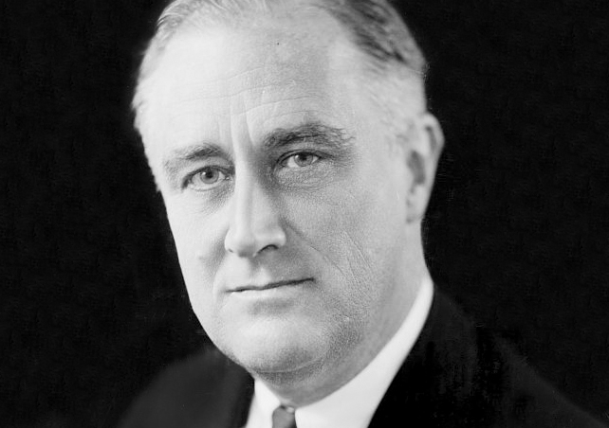
Historical Example
1937 President Franklin Roosevelt announced his plan to add new justices to expand and “reshape” the US Supreme Court after the Court ruled specific policies unconstitutional; (add a younger justice for each justice over 70)
He said it was to increase judicial efficiency because many of the Justices were older;
Many felt he was trying to pack the court with appointees that would be more favorable to his policies (New Deal, etc.).
Notes:
Provide background on the historical example provided…packing the court. See speaker notes.
https://www.whitehouse.gov/about-the-white-house/presidents/franklin-d-roosevelt/

Slide 16
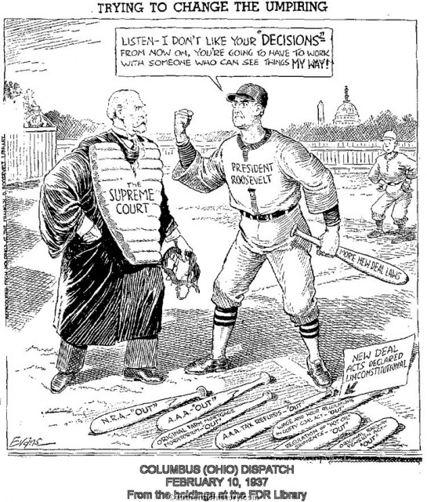
Court packing

Slide 17
The Last Word
During this time, Congress wanted the power to be able to overrule US Supreme Court decisions they did not agree with;
Who should have the last word on what the Constitution means?
If these changes had passed, what impact would this have on our system of checks and balances?
Notes:
Audience interaction.

Slide 18
Check it out
“If men were angels, no government would be necessary. If angels were to govern men, neither external nor internal controls on government would be necessary. In framing a government which is to be administered by men over men, the great difficulty lies in this: you must first enable the government to control the governed; and in the next place oblige it to control itself.”
― James Madison, Federalist Paper 51
Notes:
Transition into discussion about checks and balances

Slide 19
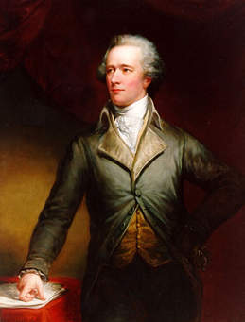
Distinguishing differences
Alexander Hamilton
- Federalist 78 -
“...there is no liberty if the power of judging be not separated from the legislative and executive powers.”
“…the courts were designed to be an intermediate body between the people and the legislature.”
Notes:
Highlight quotes on screen.

Slide 20
How are the powers of the legislative and executive Branches Checked by the Judicial Branch?
Judicial Branch
Can declare acts of Congress or Executive acts unconstitutional
Compensation of federal judges cannot be diminished
Federal judges serve for life
Chief Justice presides over Presidential impeachment trials

Slide 21
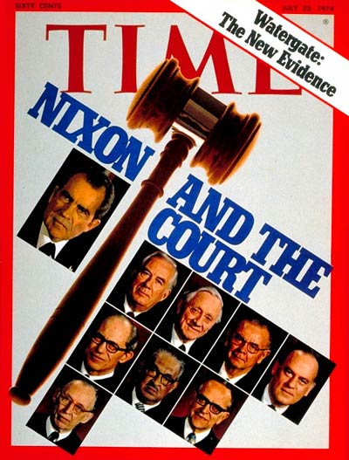
United States v. Nixon (1974) unanimous decision 8-0
The president is not entitled to automatic immunity from the legal process
“These are the considerations justifying a presumptive privilege for Presidential communications. The privilege is fundamental to the operation of Government, and inextricably rooted in the separation of powers under the Constitution…But this presumptive privilege must be considered in light of our historic commitment to the rule of law.”
418 US 683 (1974)
What is the “rule of law”?
http://content.time.com/time/covers/0,16641,19740722,00.html
Notes:
Review facts of case.
US v. Nixon unanimous decision 8-0 (Justice Rhenquist recused)
Review facts from oyez or other sites provided.
Facts: A grand jury returned indictments against seven of President Richard Nixon's closest aides in the Watergate affair. The special prosecutor appointed by Nixon and the defendants sought audio tapes of conversations recorded by Nixon in the Oval Office. Nixon asserted that he was immune from the subpoena claiming "executive privilege," which is the right to withhold information from other government branches to preserve confidential communications within the executive branch or to secure the national interest. Decided together with Nixon v. United States.
Question: Is the President's right to safeguard certain information, using his "executive privilege" confidentiality power, entirely immune from judicial review?
Outcome: No. The Court held that neither the doctrine of separation of powers, nor the generalized need for confidentiality of high-level communications, without more, can sustain an absolute, unqualified, presidential privilege. The Court granted that there was a limited executive privilege in areas of military or diplomatic affairs, but gave preference to "the fundamental demands of due process of law in the fair administration of justice." Therefore, the president must obey the subpoena and produce the tapes and documents. Nixon resigned shortly after the release of the tapes.
https://www.oyez.org/cases/1973/73-1766

Slide 22
How is the power of the Judicial Branch Checked?
Executive Branch
Appointment of federal judges
Pardon power
Executive enforcement
Legislative Branch
Determines jurisdiction of some courts
Can alter the size of the Court
Initiate constitutional amendments in response to court decisions
Senate confirms/rejects federal judicial appointments to check power of Presidential appointments
Impeach and remove judges (only for treason, high crimes etc.) not for disagreement with decision of court
Establish inferior courts

Slide 23
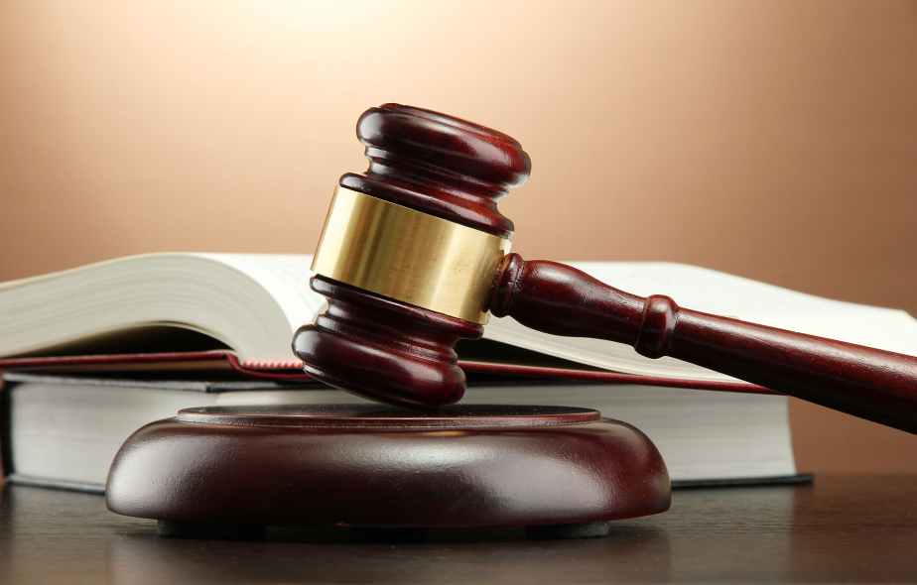
The Judicial Branch
The Judicial Branch was not designed to be a political or representative branch.
Notes:
Judges should decide cases based on the facts and law and not what the majority wants. We expect them to apply the same rules in the same manner to everyone and not just the rights of the most popular or the most powerful.
If judges are expected to follow the majority’s will, what may happen?
“the Framers called on the judiciary to patrol the Constitution’s legal boundaries and preserve the rule of law not because they believed judges to be wiser or smarter than those in the government’s other branches; rather, the Framers believed that allowing the other branches to police themselves was too dangerous.” Pariente and Robinson

Slide 24
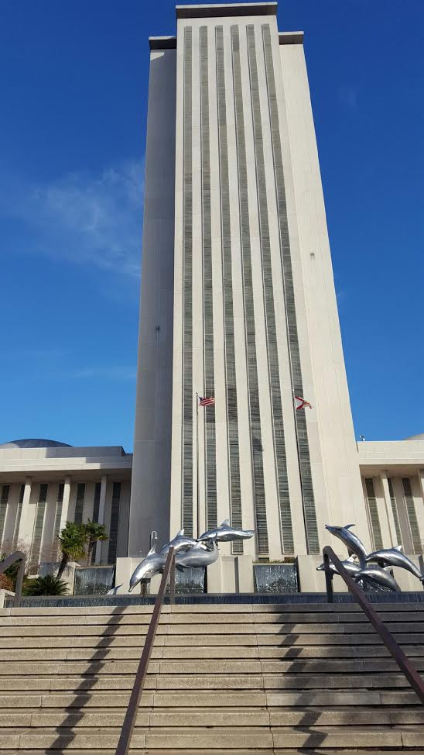









The Legislative and Executive Branches
May be influenced by:
Public Opinion or Pressures
Political Parties
Lobbyists
Constituents
Special interest groups
Personal opinion
Other
Notes:
Highlight that the legislative/executive branches make decisions based on many factors: the influence of the general public, media/public perception, constituents, lobbyists and interest groups, political parties, and personal feelings/beliefs. The outcome is legislation/policy molded by a combination of those factors.
On any given day, you will see a wide range of special interests groups coming and going from the legislature to impact public policy. In the courts, you will not special interests visiting judges to seek to influence their decision in a case. The only influence should be the law – past case precedent, the US Constitution, state Constitution etc..
The legislative and executive branches of government – are intended to reflect the people they represent and to respond to issues/policies impacting their communities This is the design of the system.

Slide 25
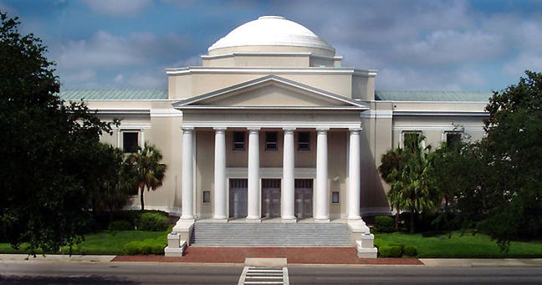
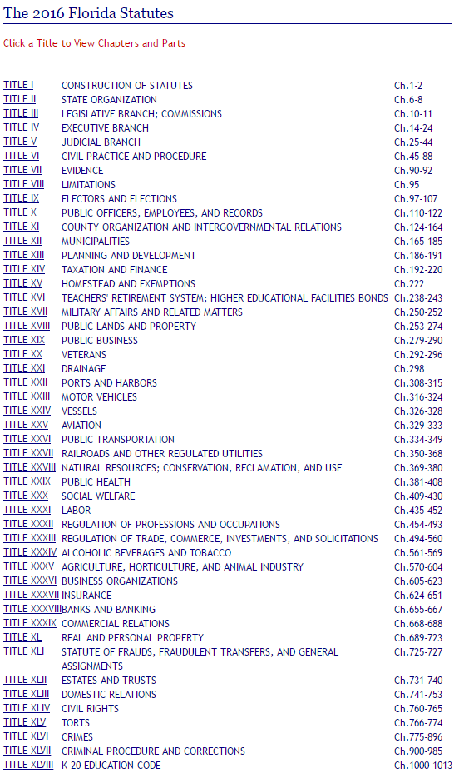
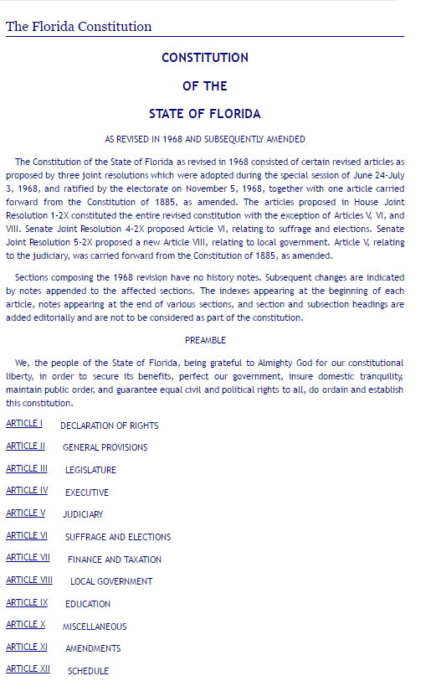
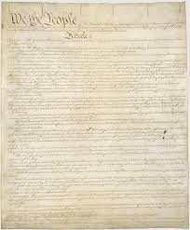
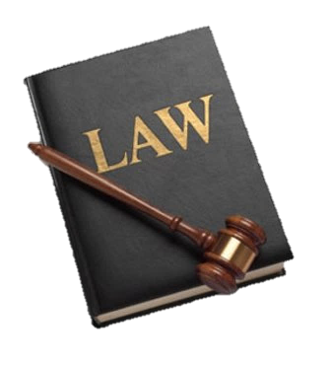
The Judicial Branch
Fair and impartial courts should not be influenced by public opinion, political pressures, or special interests. Decisions should be based on the law.
Notes:
There are distinct differences between the judicial branch and the other two. What distinguishes judicial decision making from the other branches of government is that judges make decisions based on the law, past precedent, the state Constitution, and the U.S. Constitution. The judicial branch was created to be insulated (protected) from pressures that exist on the other branches of government – media, public opinion, influence of interest groups and politics, etc. It was not structured to be a political or representative branch.

Slide 26
What would happen if…?
Judges often have to make difficult decisions in accordance with the Constitution that may not be popular. What would happen if judges decided cases based solely on what the public, special interest groups, or politicians wanted?
Notes:
What could happen if the courts were beholden to public opinion or the will of the majority. This section addresses some decisions that were likely unpopular at the time.

Slide 27
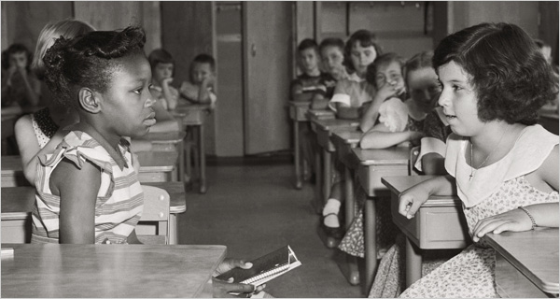
Brown v. Board of Education (1954)
At the time of the Brown v. Board of Education ruling over one-third of states segregated their schools by law.
17 southern and border states, along with the District of Columbia, required their public schools to be racially segregated.
From the unanimous opinion:
We conclude that in the field of public education the doctrine of "separate but equal" has no place. Separate educational facilities are inherently unequal. Therefore, we hold that the plaintiffs and other similarly situated . . . are . . . deprived of the equal protection of the laws guaranteed by the Fourteenth Amendment.
Notes:
Image: https://static01.nyt.com/images/2006/12/10/weekinreview/10liptak.600.jpg
Review briefly Brown I (1954) (racial segregation in violation of the Equal Protection Clause of Fourteenth Amendment) and Brown II (states required to integrate with all deliberate speed).
http://www.pbs.org/wnet/supremecourt/rights/landmark_brown.html
Ask the audience to consider what the popular opinion at the time would have been. Was the decision in Brown popular? What if the Justices made their decision based on public opinion, the legislative branches’ wishes, or personal opinion? Should unpopular decisions be an impeachable offense?
Article Details:
10 Things You Should Know About Brown v. Board of Education
Author
Jesse Greenspan
Website Name
History.com
Year Published
2014
Title
10 Things You Should Know About Brown v. Board of Education
URL
http://www.history.com/news/10-things-you-should-know-about-brown-v-board-of-education
Access Date
December 08, 2016
Publisher
A+E Networks

Slide 28
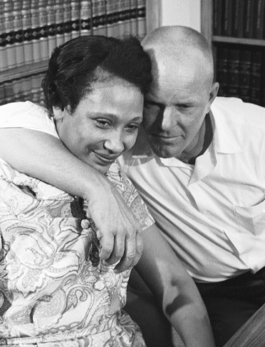
Loving v. Virginia (1967)
In 1958, two residents of Virginia, Mildred Jeter, a black woman, and Richard Loving, a white man, were married in the District of Columbia. They returned to Virginia shortly thereafter.
The couple was then charged with violating the state's antimiscegenation statute, which banned inter-racial marriages. They were found guilty and sentenced to a year in jail (the trial judge agreed to suspend the sentence if they would leave Virginia and not return for 25 years).
The US Supreme Court applied the 14th Amendment to determine that “Under our Constitution, the freedom to marry, or not marry, a person of another race resides with the individual, and cannot be infringed by the State.”
Notes:
Image: http://newshour.s3.amazonaws.com/photos/2012/07/03/72450033_slideshow.jpg
Highlight facts from Loving v. Virginia.
Video clip describing case: https://search.aol.com/aol/video?q=video+clips+and+loving+US+Supreme+court+decision+case+study+interracial&s_it=video-ans&sfVid=true&videoId=088DF888A63A3E764E47088DF888A63A3E764E47&v_t=webmail-searchbox
By 1967, 16 states had still not repealed their laws forbidding interracial marriages. Mildred and Richard Loving were residents of one such state, Virginia, who had fallen in love and wanted to get married. Under Virginia’s laws, however, Richard, a white man, could not marry Mildred, a woman of African-American and Native American descent. The two travelled to Washington D.C. where they could be married, but they were arrested state law which prohibited inter-racial marriage. Because their offense was a criminal conviction, after being found guilty, they were given a prison sentence of one year. The trial judge suspended the sentence for 25 years on the condition that the couple leave Virginia. On Appeal, the Supreme Court of Appeals of Virginia ruled that the state had an interest in preserving the “racial integrity” of its constituents and that because the punishment applied equally to both races, the statute did not violate the Equal Protection Clause of the 14th Amendment. The United States Supreme Court in a unanimous decision reversed the Virginia Court’s ruling and held that the Equal Protection Clause required strict scrutiny to apply to all race based classifications. Furthermore, the Court concluded that the law was rooted in invidious racial discrimination, making it impossible to satisfy a compelling government interest. The Loving decision still stands as a milestone in the Civil Rights Movement.

Slide 29
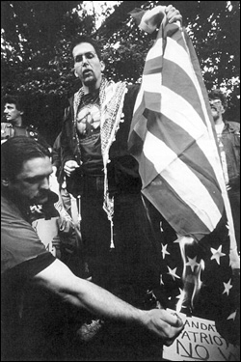
Texas v. Johnson (1989)
"If there is a bedrock principle underlying the First Amendment, it is that the government may not prohibit the expression of an idea simply because society finds the idea itself offensive or disagreeable. . . "
- - Justice William Brennan, speaking for the majority
On Flag Burning:
“If I were king, I would not allow people to go about burning the American flag. However, we have a First Amendment, which says that the right of free speech shall not be abridged.”
- - Justice Antonin Scalia
http://supremecourthistory.org/assets/16_a.jpg
Notes:
Review the facts in the Texas v Johnson case and decision of the US Supreme Court. Discuss how personal opinions should not enter into judicial decision making.
http://www.nytimes.com/2012/07/19/us/politics/justice-scalia-says-he-had-no-falling-out-with-chief-justice-roberts.html

Slide 30
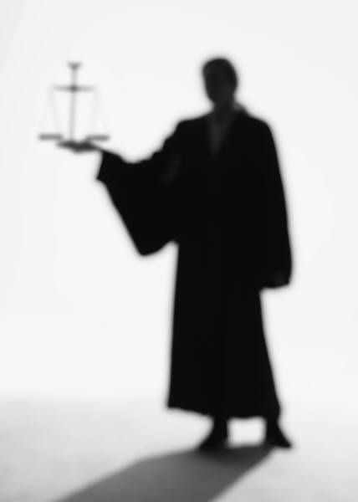
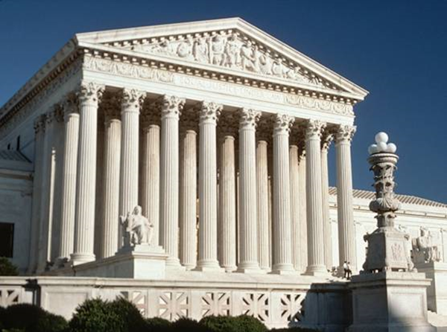
So…What is important to you?
When you walk into the courtroom and face the judge…
…what qualities or characteristics are most important to you?
Notes:
Ask the audience (no matter what the case) when they walk into a courtroom to face a judge, what qualities or characteristics are most important to you?
Receive responses from full audience.

Slide 31
Responses
Knowledge of the law
Legal/Judicial Experience
Temperament/Demeanor
Involvement in the community
Character/ethics
Educational background
Disciplinary record
Impartiality/fair and impartial
Notes:
Address responses from previous groups and add additional responses.

Slide 32
What should judges not consider when making decisions?
Judges should make decisions based on the facts and the law.
They should NOT consider:
Political influences
Special interests
Financial influences
Public opinion
Media influences
What else would you add?
Notes:
Now ask what judges should NOT consider when making judicial decisions.

Slide 33
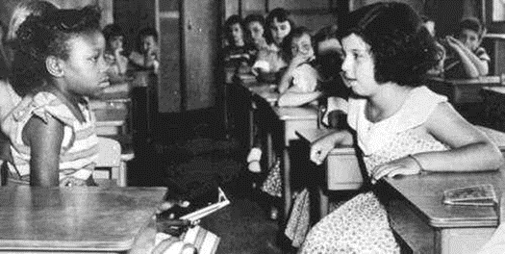
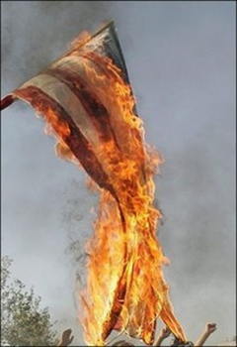
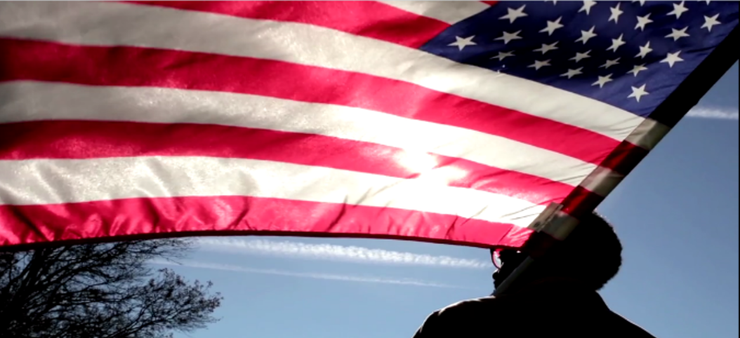
The Essential Role of the Judiciary
“A Judge is bound to decide each case fairly, in accord with the relevant facts and applicable law, even when the decision is not the one the home crowd wants.” -- William H. Rehnquist, Chief Justice 1986-2005
“If you’re going to be a good and faithful judge, you have to resign yourself to the fact that you’re not always going to like the conclusions you reach. If you like them all the time, you’re probably doing something wrong.” -- Justice Antonin Scalia
Notes:
Ultimately emphasize that Judges should decide cases based on the facts and law and not what the majority wants. We expect them to apply the same rules in the same manner to everyone and not just the rights of the most popular or the most powerful.

Slide 34
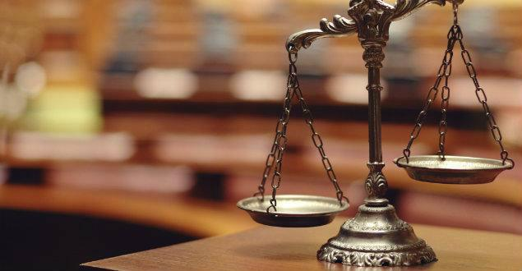

Balance of power extends to state government
Notes:
Highlight separation of powers at the state level. Emphasize state constitutions and state government.

Slide 35
State Legislative Attempts to Weaken the Role or Independence of the Courts - 2018
In 2018, as of January 31, legislatures in at least 14 states are considering legislation that would diminish the role or independence of the courts:
Twenty-three bills in eight states would inject greater politics into how judges are selected
Four bills in four states would increase the likelihood of judges facing discipline or retribution for unpopular decisions or would politicize court rules or processes
Six bills in three states would cut judicial resources or establish more political control over courts in exchange for resources
Four bills in three states would manipulate judicial terms, either immediately removing sitting judges or subjecting judges to more frequent political pressures
Four bills in four states would restrict courts’ power to find state legislative acts unconstitutional
Notes:
Emphasize attempts to weaken the role or independence of the courts.
on the state level.
Think back to questions asked earlier…would you recognize these attempts

Slide 36




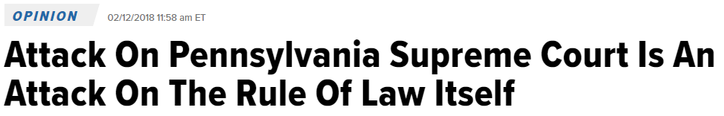

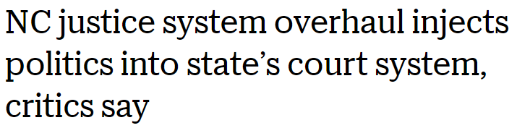
Pennsylvania lawmaker calls for impeachment of state Supreme Court judges who struck down congressional map
Notes:
Highlight some of the headlines from other states.
http://www.washingtonexaminer.com/pennsylvania-lawmaker-calls-for-impeachment-of-state-supreme-court-judges-who-struck-down-congressional-map/article/2648228
http://www.newsobserver.com/opinion/op-ed/article189643459.html
http://www.charlotteobserver.com/news/politics-government/article194374559.html
From Headline 1 - http://www.abajournal.com/news/article/the_north_carolina_legislature_is_attacking_judges_who_rule_against_it/
“As the courts have protected voting rights and required the legislature to fix unfair gerrymanders, legislators have lashed out at judges and passed bills giving them more control over courts…”
Ended public financing for judicial elections (2013)
Changed the judicial election system by requiring candidates to represent a political party
Cancelled judicial primaries
Eliminated seats on the court of appeals

Slide 37
The North Carolina legislature is attacking judges who rule against it BY BILLY CORRIHER
“As the courts have protected voting rights and required the legislature to fix unfair gerrymanders, legislators have lashed out at judges and passed bills giving them more control over courts…”
Ended public financing for judicial elections (2013)
Changed the judicial election system by requiring candidates to represent a political party
Cancelled judicial primaries
Eliminated seats on the court of appeals
Notes:
From the article:
“These kinds of responses from legislators, the statements and the alleged retaliation against judges, are an attack on the independence of North Carolina courts. In the last couple of years, the legislature’s veto-proof …majority has repeatedly changed how the state’s judges are chosen in ways that would get their preferred judges on state courts.
The most drastic attack on North Carolina’s courts were two proposed state constitutional amendments. One would have essentially put the legislature in charge of choosing judges. Legislators called their plan a “merit selection” system, but unlike most such systems, North Carolina’s merit selection commission would not be charged with narrowing down the candidates and selecting a few to send to the governor, as they are in most merit selection systems. This commission would merely be responsible for deciding if candidates are qualified. Legislators would choose three names from the long list of qualified candidates, and the governor would pick one person from the legislature’s short list.
The other amendment would have shortened judges’ terms to just two years—the shortest in the nation.

Slide 38
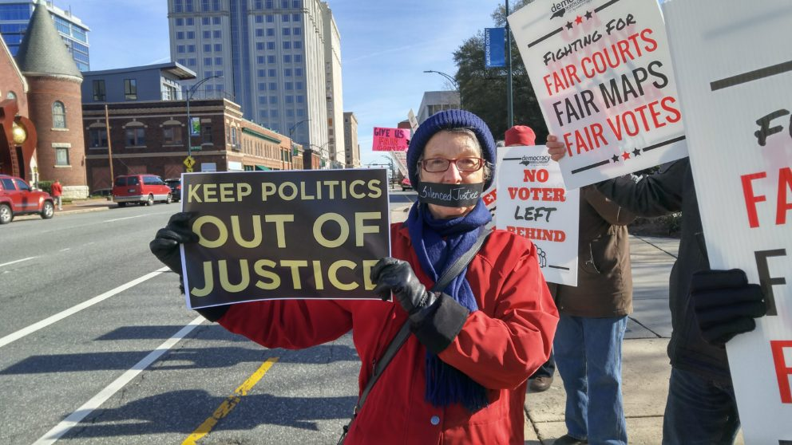
Responding to Threats to weaken judicial branch powers
North Carolina group We are Democracy North Carolina held Fair Courts Day protests focused on:
Gerrymandering of judicial voting districts
“Slashing” judicial terms
And legislative appointment of judges
https://democracync.org/wp-content/uploads/2017/12/1213171212_HDR-992x558.jpg
Notes:
https://democracync.org/faircourts/
Highlight that in some states groups are organizing to protect the powers of the courts and to keep politics out of justice.

Slide 39

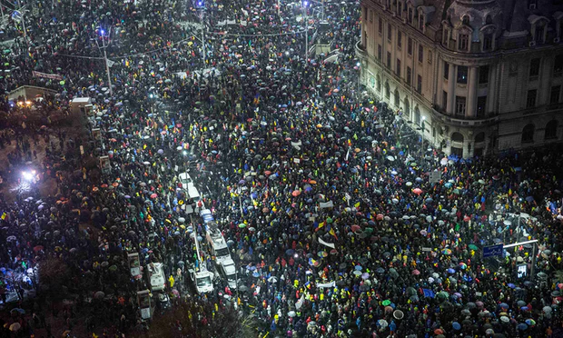

Responding to Threats to weaken the judicial branch: An International Perspective
Notes:
Demisia translated is “Resign”
In Romania, tens of thousands of Romanians protested in the snow to oppose laws that would weaken judicial independence.
What would happen in the United States? Would the public stand up and defend the rule of law and an independent judiciary. On such a level?

Slide 40
Where do you stand?
How important is separation of powers in our constitutional structure?
Would you recognize attempts by other branches, groups, or individuals to gain more control/power or to weaken the powers of another branch?
Why is it important for the public to understand the role of the judiciary in safeguarding the Constitution, protecting our rights, and upholding the rule of law?
Why is it important for courts to be insulated from political pressure and other external influences?
Notes:
End the presentation with these and other important reflective questions. You can have the audience provide answers or just review for thoughtful reflection before concluding.

Slide 41
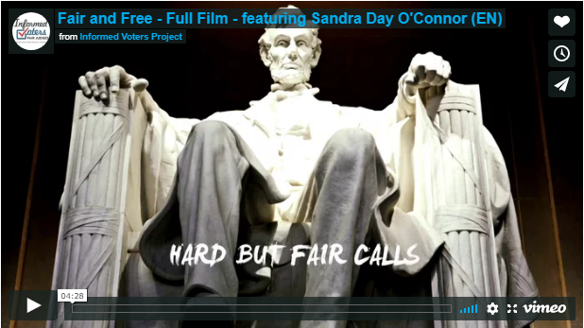

Informed Voters, Fair Judges Project www.ivp.nawj.org
Notes:
Key messages: Our courts should be the one branch separate from politics. ➢ Judges should be evaluated based on their character and integrity. ➢ The Courts must be protected from those who would politicize them. ➢ The public must be educated about special interest efforts to politicize the courts.
Show video.
http://www.ncsl.org/research/about-state-legislatures/separation-of-powers.aspx
https://www.archives.gov/education/lessons/separation-powers

